Slide 1

Shri Ramdeo Baba College Of Engineering and Management Nagpur
Topic Name:- National Ambient Air Quality Standard 2009
Name:- Ganesh Narayan Moroliya
Roll No:- 102
Semester:- 4th
Section:- A
Branch:- Electronics and Communication

Slide 2
Contents :-
Introduction about National Ambient Air Quality Standard
What is National Ambient Air Quality Standard?
Objectives of the Standard
Air pollutants
Significance of NAAQS 2009
Conclusion

Slide 3


National Ambient Air Quality Standard 2009
The air we breathe is essential to our lives and to the environment. In India, National Ambient Air Quality Standards (NAAQS) help regulate the quality of air to ensure that it's fit for the people and beneficial for the ecosystem. In this presentation, we will explore NAAQS and the significance of the Standard for our health and the environment.

Slide 4
What is National Ambient Air Quality Standard?
National Ambient Air Quality Standard (NAAQS) is the specified level of air quality that must be achieved and maintained across the country. The Central Pollution Control Board (CPCB) established NAAQS as per the Air (Prevention and Control of Pollution) Act, 1981, which covers 12 air pollutants. Some of the major aims of NAAQS are to promote public health, welfare, and protect the ecosystem from the adverse impacts of pollution.

Slide 5
Objectives of the Standard
Protect Ecosystem
The Standard is designed to promote and maintain better ecological systems, including forests, lakes, rivers, and natural habitats.
1
2
3
Minimize Health Hazards
Promote Sustainability
The NAAQS aims to reduce air pollutants to a level that does not pose any significant danger to human health.
The NAAQS is crucial to sustainable development and helps maintain a balance between development and environmental protection.

Slide 6
Air pollutants
PM 10 (Particulate Matter)
Nitrogen Dioxide (NO2)
PM 2.5 (Particulate Matter)
Sulphur Dioxide (SO2)
Carbon Monoxide (CO)
Ozone (O3)
Lead
Arsenic
Ammonia (NH3)
Nickel
Benzene
Benzo Pyrene

Slide 7
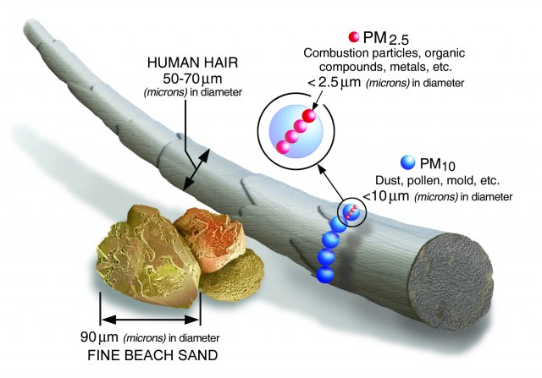
PM 2.5 and 10

Slide 8
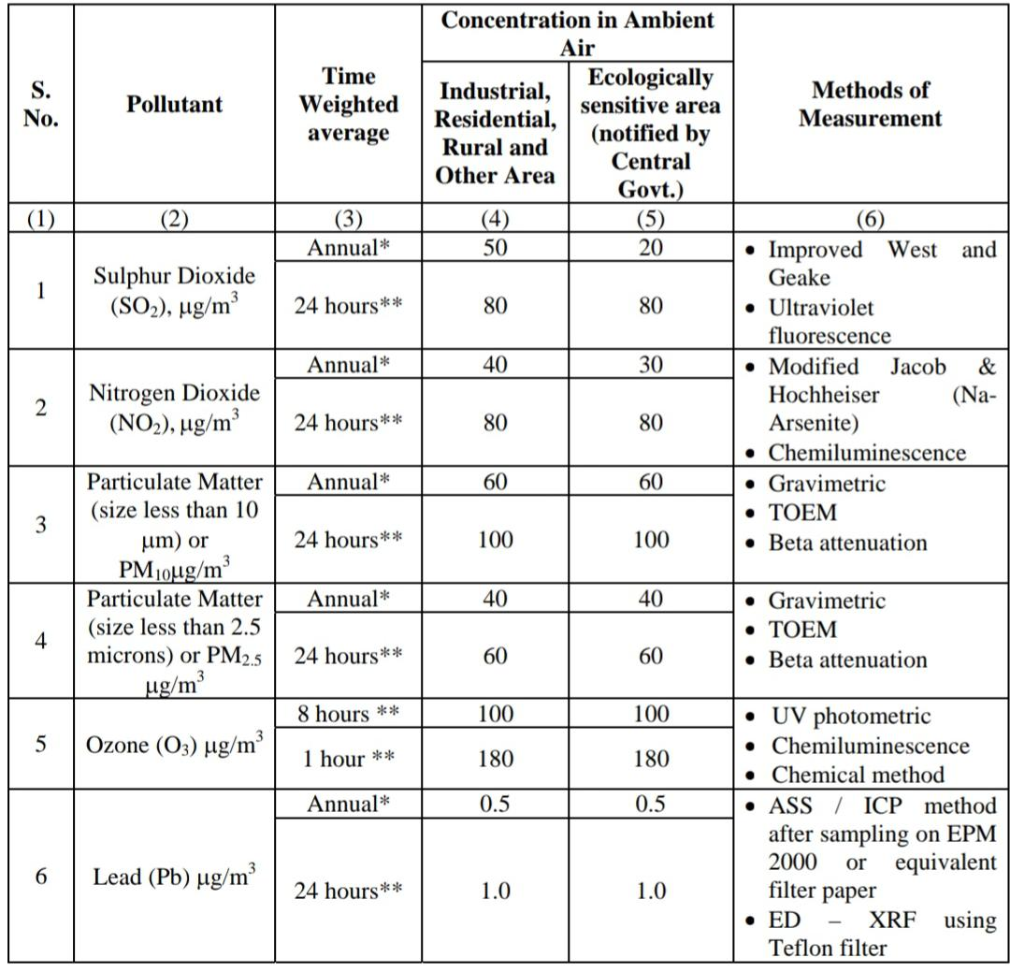
AAS

Slide 9
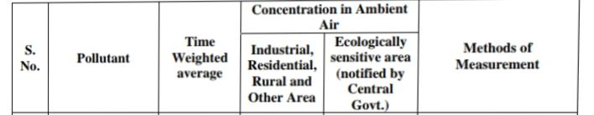
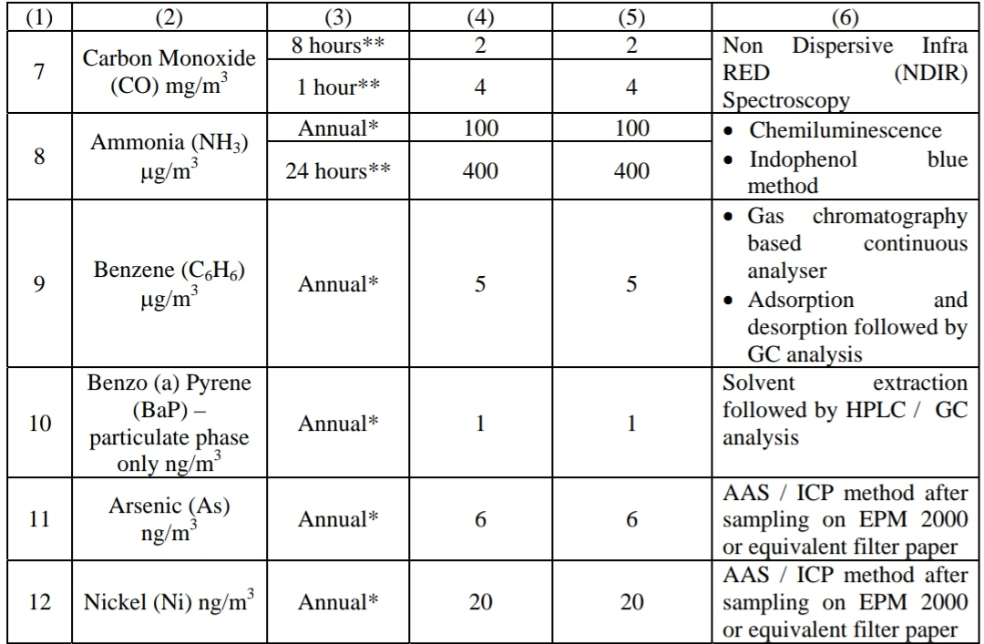

Slide 10
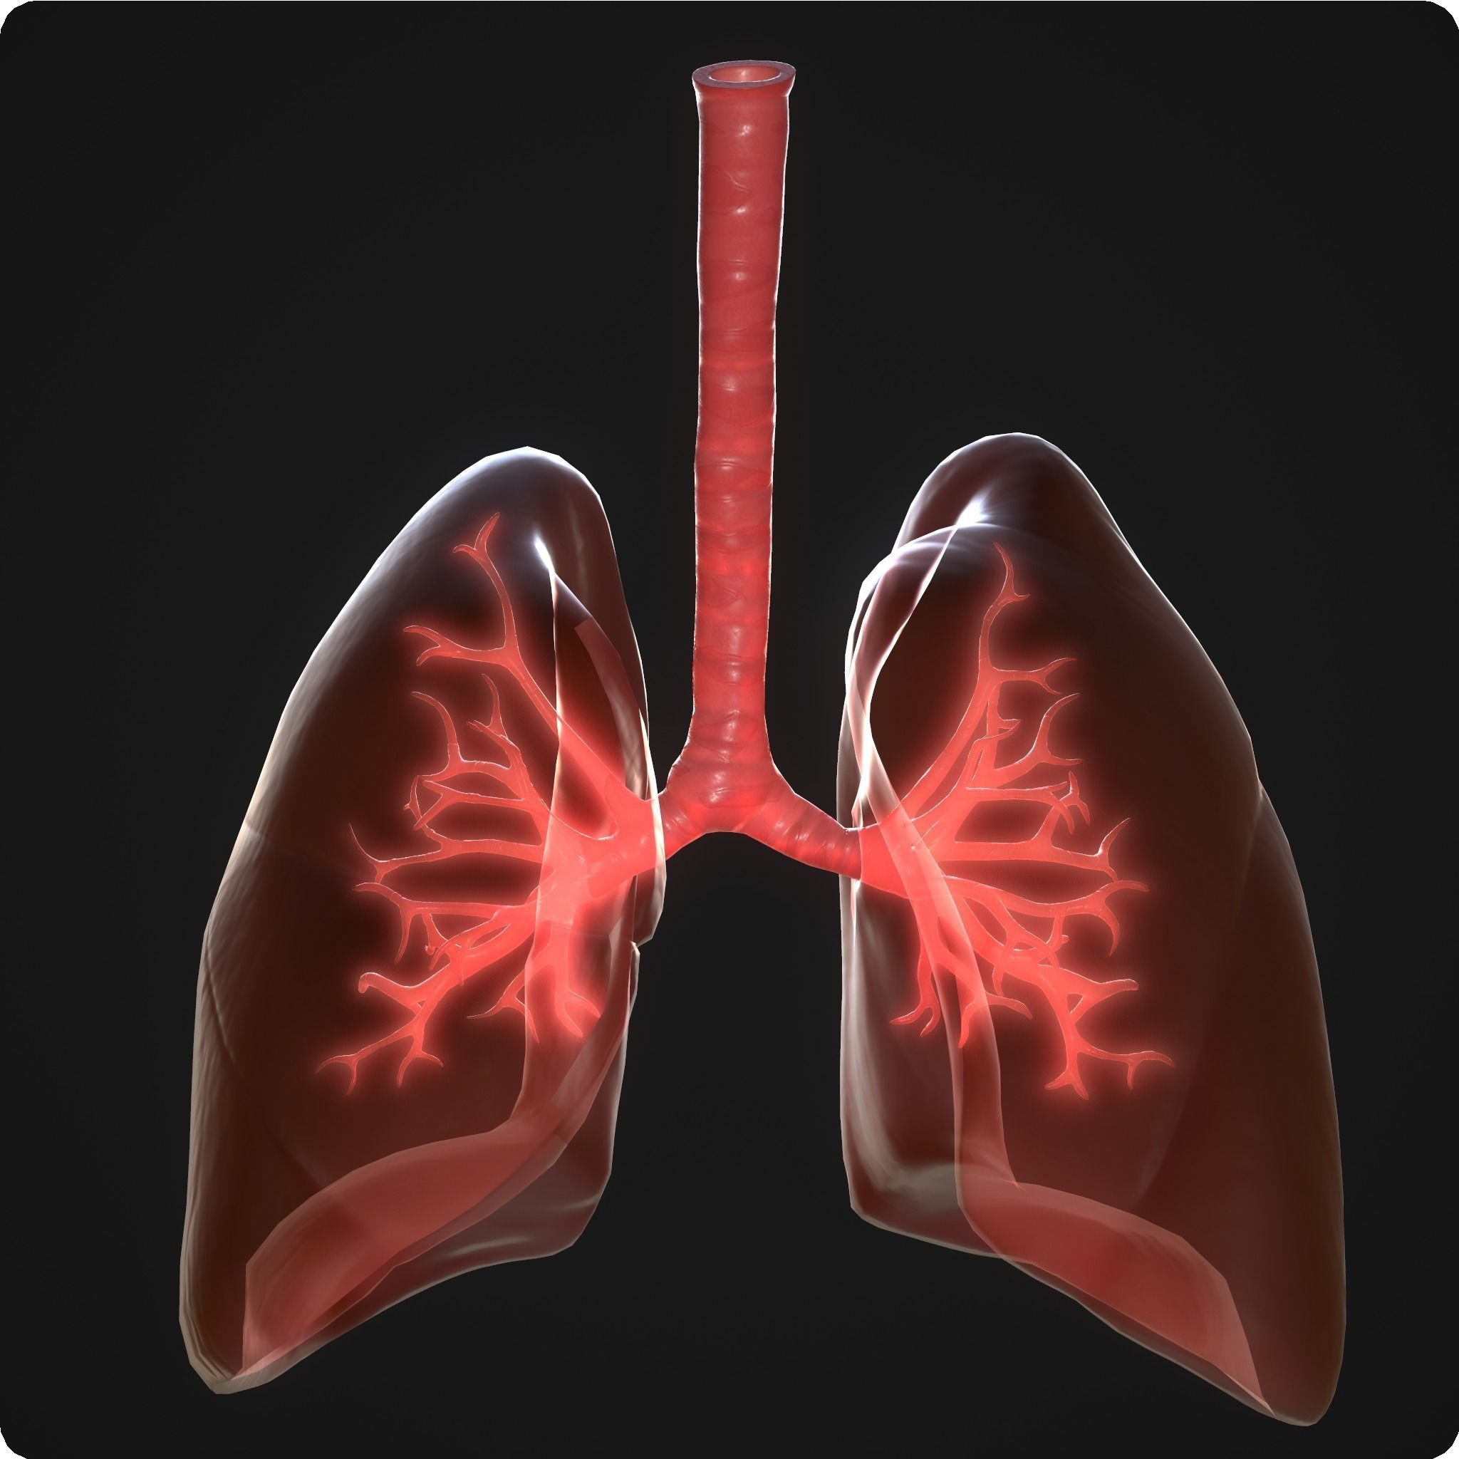


Significance of National Ambient Air Quality Standard 2009
Protects Human Health
Protects the Environment
Encourages Sustainable Practices
The NAAQS aims to regulate air quality to acceptable levels, reducing health hazards and promoting well-being for everyone.
The Standard is essential in safeguarding ecosystems like forests, aquatic systems, and wildlife, as air pollution can cause damage to biodiversity.
The NAAQS promotes the use of cleaner technologies and practices, reducing negative impacts of industrial processes on human, animal, and plant health.

Slide 11

Conclusion
The National Ambient Air Quality Standards are critical to protecting human health and the environment. That’s why we should maintain our environment by reducing air pollution for breathing The fresh air

Slide 12
Thank you

